Slide 1

STABILITY ASSESSMENT OF HIGH CUT SLOPES IN SOFT ROCKS - A CASE STUDY, DUBAI.
Mohammad K Shatnawi | Mohammed. J Ahmed | K. Mohammed Musthafa | Kurian Jacob | Kashif Nadeem
Presenter,
K. Mohammed Musthafa
04th December 2018

Slide 2
OUTLINE OF PRESENTATION
Introduction
Geology
Joint data collection
Sampling & Lab testing
Methodology of Analysis
Empirical and Analytical checks
Conclusion & Recommendations

Slide 3
Introduction
In order to reduce substantially the carbon emissions and implement the Dubai Clean Energy Strategy 2050, the government working on major projects to diversify the energy mix and manage the demand for electricity. The energy mix plan to be generated is targeted for 25 % of solar power, 7% from nuclear, 7% from clean coal and 61% from gas by 2030. The case study project is a clean coal fired power plant of 4×600 MW.
The project besides the main structures for a typical gas based thermal plant, includes the construction of a pump house..

Slide 4
Introduction -contd
The pump house foundations involve the deepest, over 18 m of excavation, generating high cut slopes. The stability of these high cut slopes has a definite bearing on the short term safety and performance of the structures in the project.
To provide the design engineers with the required measures to design stable cut slope angle vis-à-vis slope protection measures to enhance the stability and safety of the cut slopes, the stability assessment study was taken-up during construction.

Slide 5
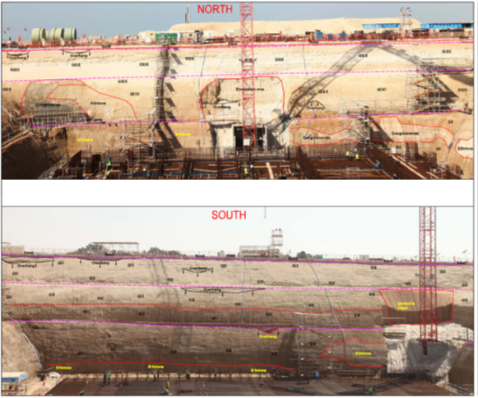
Geology
The excavated slopes consist of 0.5 – 3.0 m thick silty sandy overburden layer, below which distinctly to partially weathered sandstone (Gr.III/ II) is noticed up to a depth range of 6.0m to 18.00m thick (locally highly weathered reddish brown) followed by slightly weathered (Gr.II) Siltstone to reach of toe depth. Wide Pockets of intensely jointed/ fractured rock mass is seen distributed on the cut slope. Weathered rock mass is also noticed up to a depth below 7 m also..
In general the ground water table at the site was 2-3 m below existing ground. Extensive dewatering by pumping was resorted for handling the seepages.

Slide 6
Joint data collection
The discontinuity data including dip amount, dip direction and joint/ surface parameters were measured from the cut slopes by global or scan line method. The data collected from each slope location were analyzed using DIP-6 software. The major joint sets were identified and are shown below .
Sl. No | Joint Set | Dip Direction | Dip Amount | Dip Surface | Joint Filling | Spacing (cm) | Persistence (m) | Aperture (mm) | Weathering
1 | J1 | 132 | 34 | Rg & P1 | Si | 20-50 | 2.0 | Tg-op | III/II
2 | J2 | 29 | 18 | Rg-Un | Si | 20-50 | 2.0 | Tg | II

Slide 7
Sampling & Lab testing
In order to determine the physical properties and shear strength parameters of rock samples, laboratory tests were performed on the core samples. Rock Shear tests (on selected rock samples) from cores were carried out to assess the shear strength parameters. The typical procedure is illustrated which was followed for sample preparation and testing.

Slide 8
Methodology of analysis
Empirical method: Kinematic admissibility checks with identification of potential wedges and joint set combinations using DIPS 6 programme.
Analytical method:
Stability checks of the potential planes (by empirical method) using Rockplane, Swedge, for a FoS of 1.5 for potential cut slope.
sigmaW programme was used for circular failure condition
Protection measures: Identification of the required protection or stabilization measures if required.

Slide 9
Empirical checks
The dominant joint sets were plotted to identify potential modes of failure (plane, wedge etc.) and check the stability of the proposed cut slopes The following data was used for the empirical analysis with Dips 6 programme for the 4 slopes:
The azimuth and dip amount of the two identified joint sets .
The existing cut slope direction and angle of 45º (i.e. 1H: 1V).
Average angle of internal friction (tanΦ) of 30º.
The lateral limit of 20º.

Slide 10
Empirical checks - contd
Summary of Kinematic admissibility checks for all slopes
Cut-Slope | Slope Angle (deg) | Type of Kinematic Analysis performed
 |  | Planar | Wedge | Flexural Toppling
North Slope | 45 | X | X | X
East Slope |  |  | X | X
South Slope |  | X | X | X
West Slope |  | X | X | X
Note: X - no failure ; ✓ – potential
Based on the kinematic analysis, set J-1 (132/34) is identified to be potential for planar mode of failure on the East slope.

Slide 11
Analytical checks
The checks were performed using Rock science program (RocPlane & SWdge) software. The analysis shows a FoS = 1.08. Blocks may cause small Plane failures, which are manifested at site. No potential wedge blocks were identified in the check or noticed on the slopes. Since the slopes are temporary in nature the above FoS is considered to be acceptable.

Slide 12
Analytical checks - contd
As very weak rock with obliterated discontinuities/ joints exposed in the sections may behave typically as a soil mass, hence the global stability with the concept of circular failure was also checked. A 2D analysis (Morgenstern –Price method) for local and global cases was performed using Slope/W- a FE based software (www.geo-slope.com). The analytical checks were performed for both static and dynamic (g=0.15) cases.
Parameters for Analytical checks
Parameter | Unit | Value | Remarks
Cut slope angle…………... Cut slope height………….. Density…………………… Cohesion…………………. Friction angle……………. E- Modulus……………... | Deg M t/m³ t/m² Deg. MPa | 45 5-7 / 18 1.80/ 2.20 2/ 7 33/ 35/ 27 100 | Bench/ slope sand / rock Sandstone / Siltstone Sand /Sandstone / Siltstone Weathered sandstone & top soil.

Slide 13
Analytical checks - contd

Slide 14
Analytical checks - contd
Summary of Factor of Safety for each section

Slide 15
Conclusion & Recommendations
Highly jointed sandstones with 2 predominant sets of joints are encountered in the existing cut slopes.
The results of the analytical checks indicate the existing temporary cut slopes of 45º to be stable locally and globally.
Local failure of the blocks of <0.5 m3 are expected. It has been recommended to scale out all loose blocks from the slope surface.
The over hangs be knocked-off/ removed for safety reasons.
Seepages from the slope be directed suitably with toe drains on the benches.
The study optimized / minimized the slope protection measures.
The temporary cut slopes were considered as safe.

Slide 16

THANK YOU

